Slide 1
Numerical approximation for PDEs
Introduction to numerical simulation
V. Dolean (Victorita.Dolean@univ-cotedazur.fr)

Slide 2
Mathematical modelling and numerical simulation
Mathematical modelling
Mathematical and numerical analysis of models
Numerical simulation
Numerous fields of applications:
Engineering: mechanics, electromagnetism, geoseismics, robotics
Other fields of science: physics, biology, chemistry…
Numerous new problems arise each year (medicine, environment, climate etc…)

Slide 3
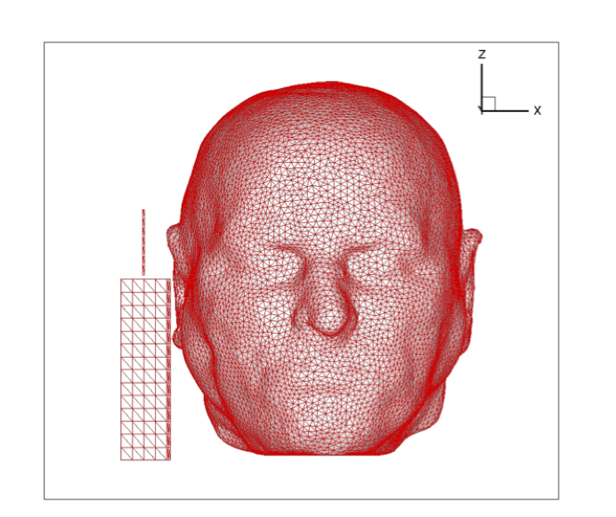
Electromagnetic waves
Mobile phones

Slide 4

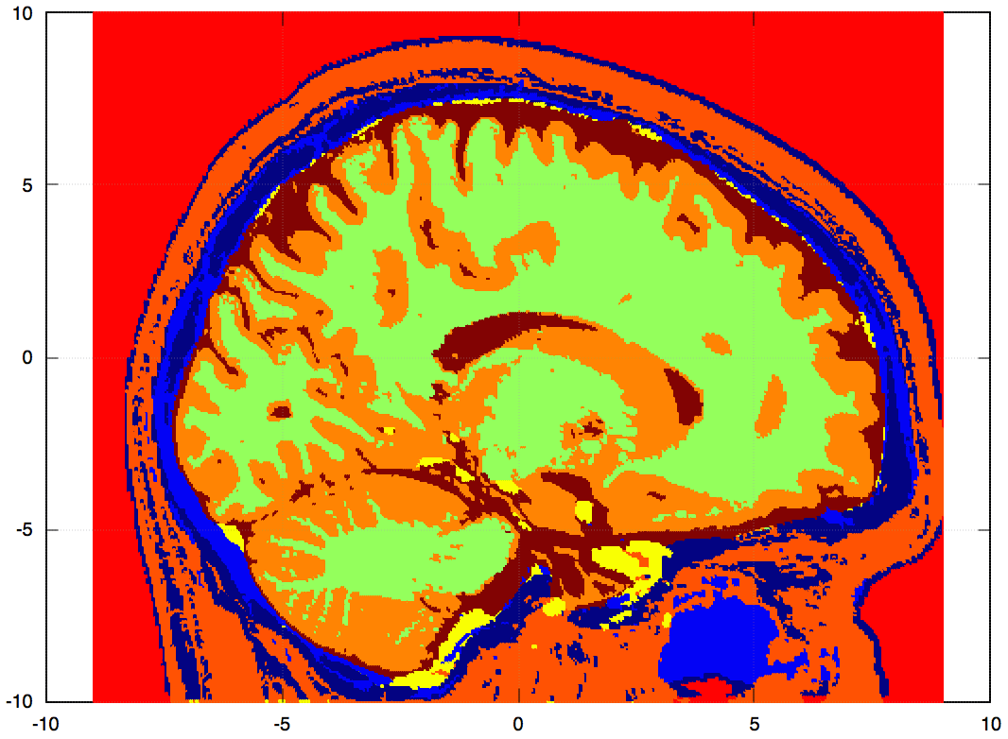
Medical imaging
Reconstruct electrical properties of the brain

Slide 5
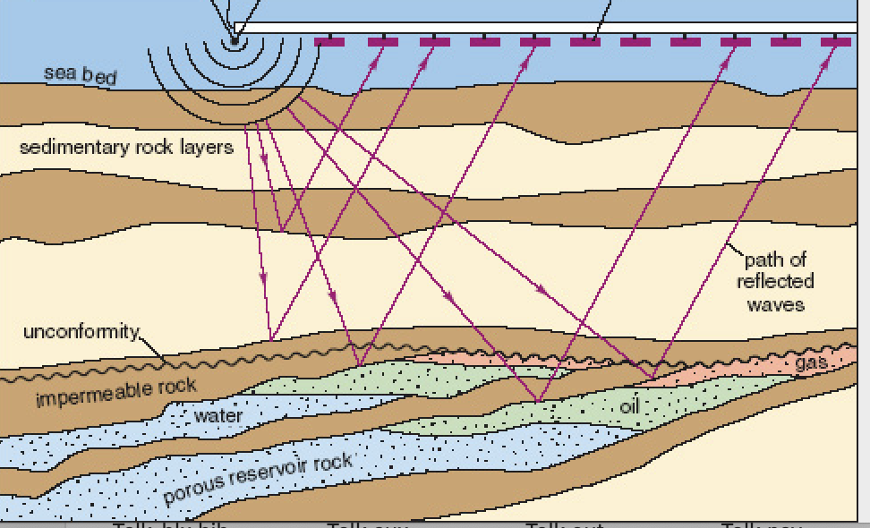
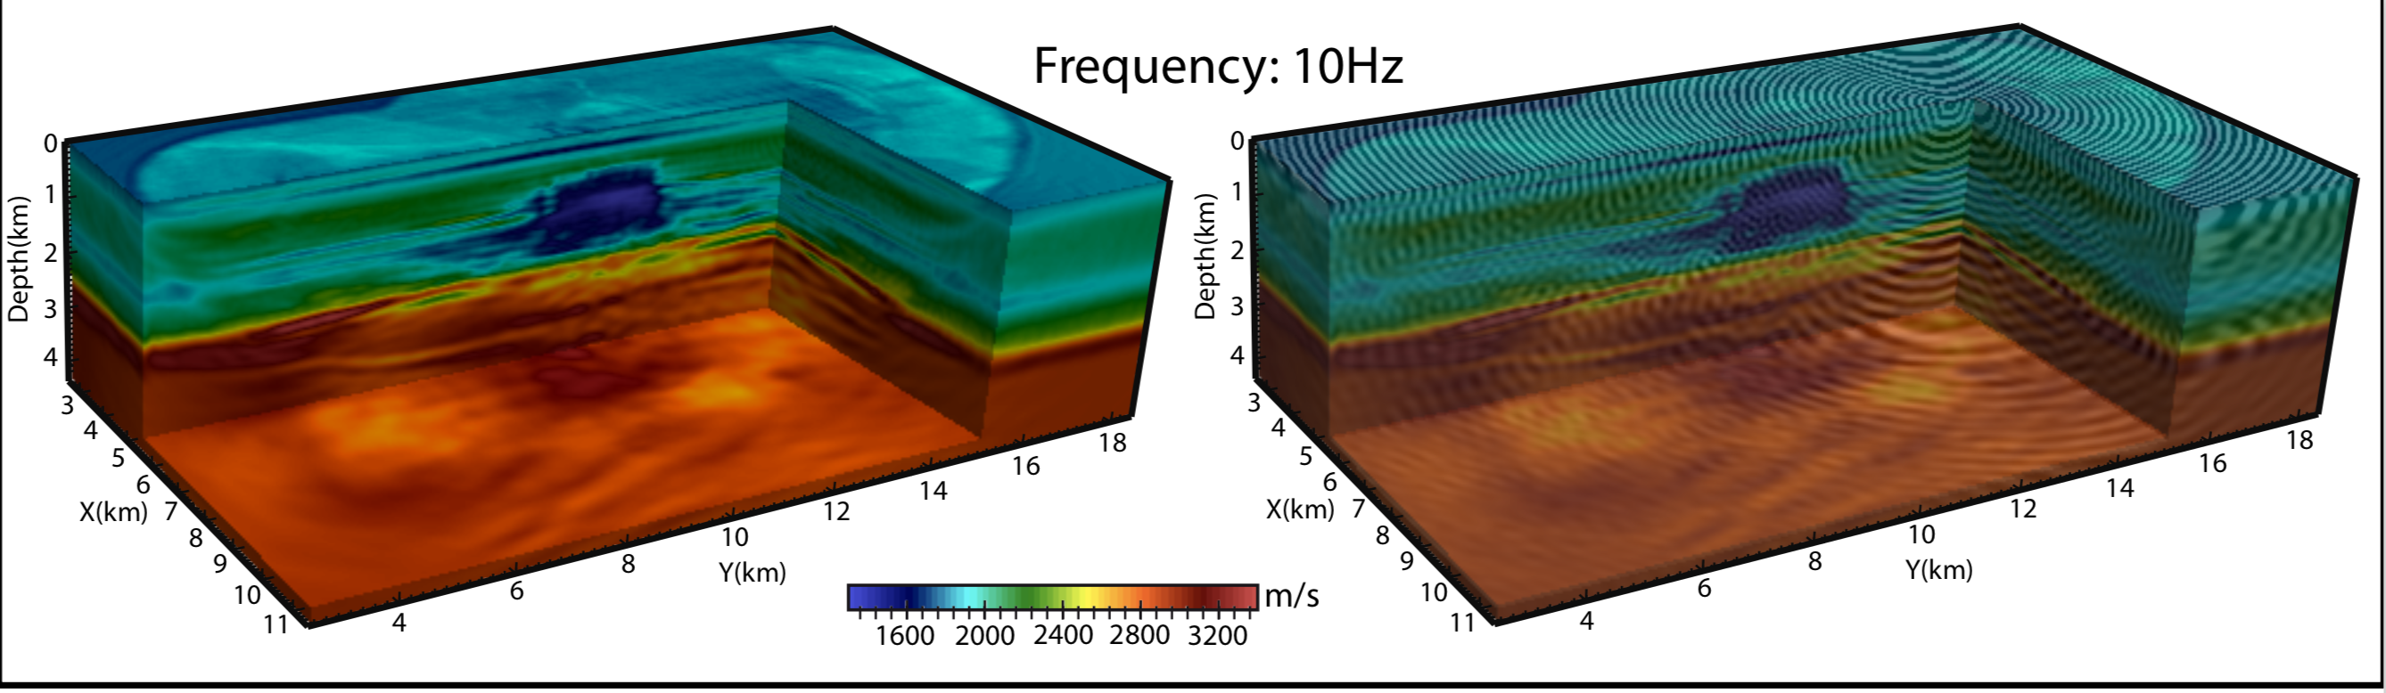
Seismic imaging
Reconstruct subsurface properties
from measures

Slide 6
Computational mechanics
A tire is a complex material
with a multiscale structure.
Mathematical model: non-linear
elasticity

Slide 7
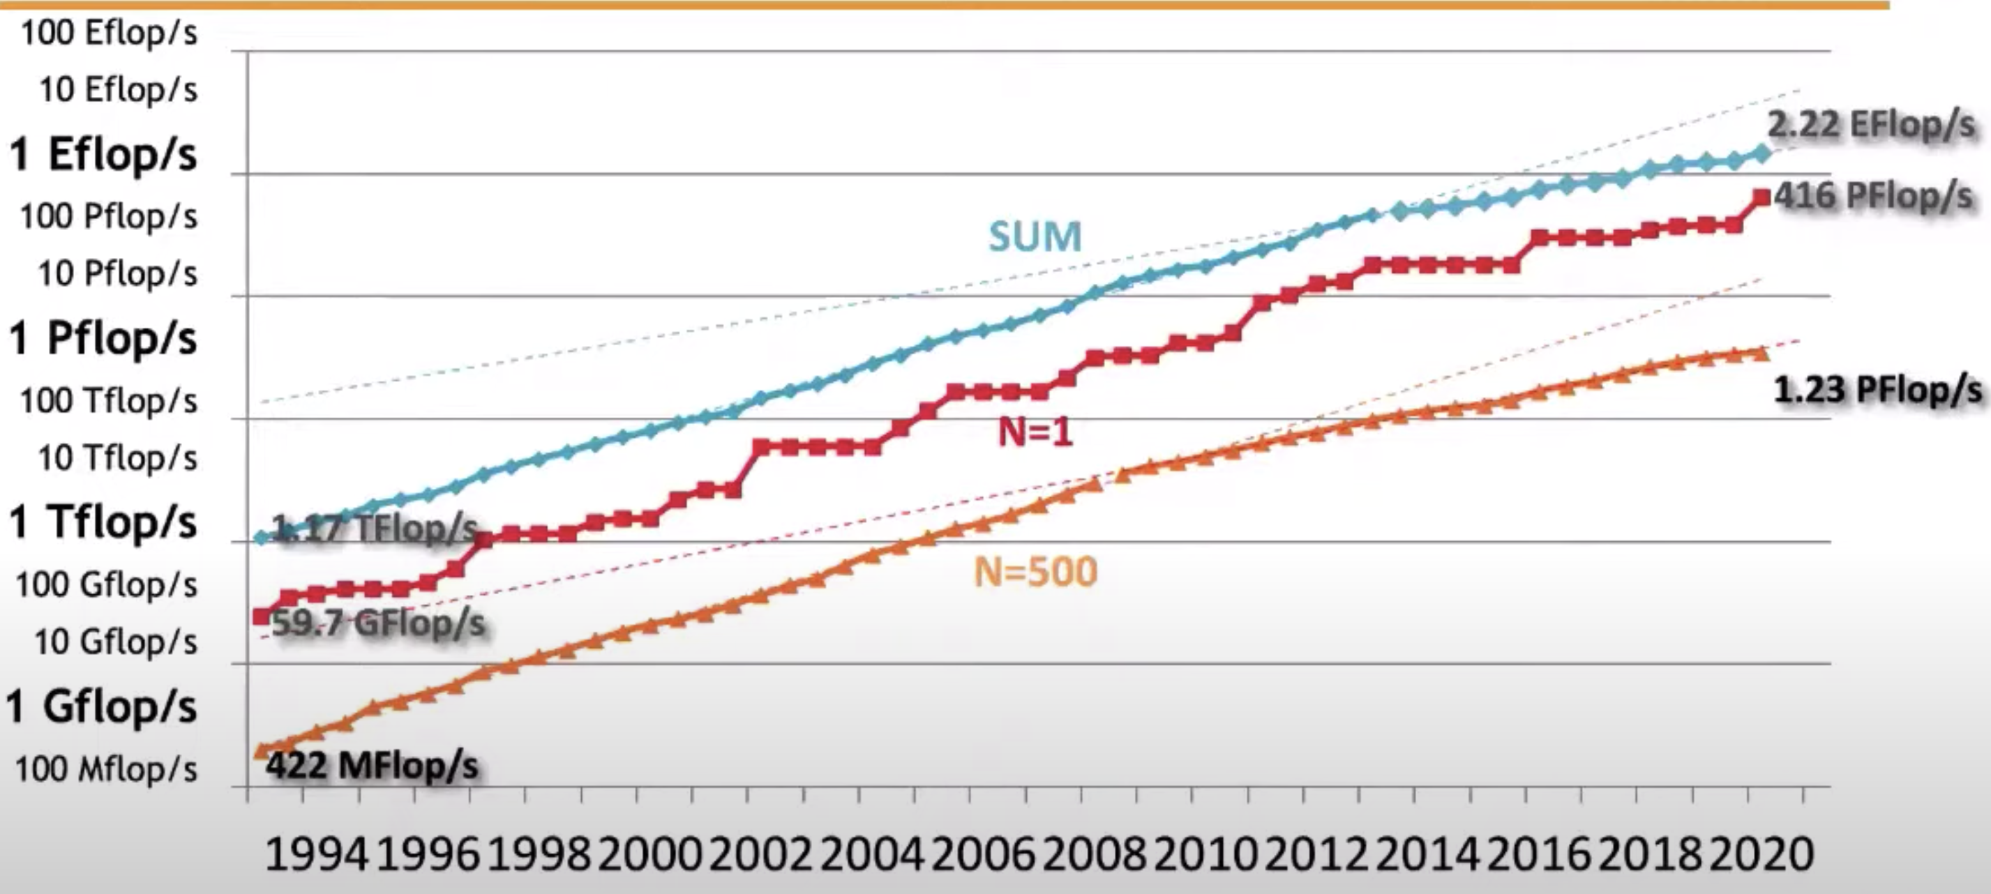
Developpement of Applied Maths
Their development explose because of powerful computers

Slide 8
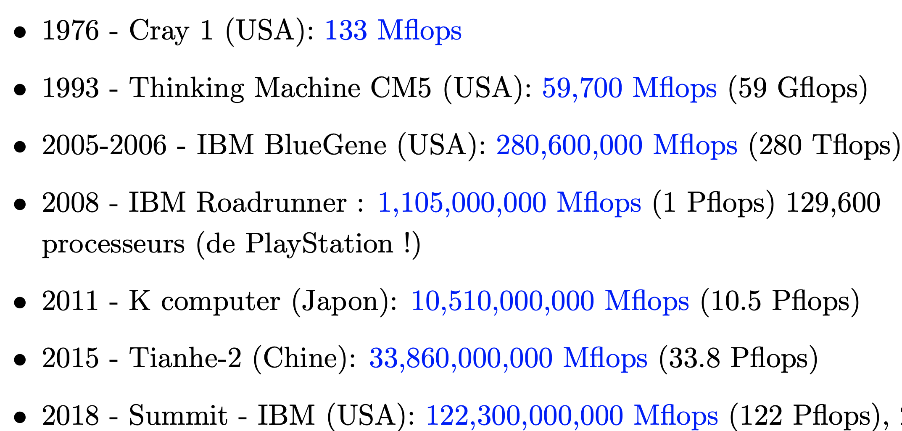
Moore’s law
Exponential growth of computer power

Slide 9
Objectives of the lecture
Acquire the (first) mathematical and numerical tools to carry out, understand and interpret numerical simulations
Purpose:
Weather prediction, environment, safety ...
Design and optimization.
Experimentation: validation of a model, verification of a theory ...
Mathematics has become an experimental science!

Slide 10
Outline of today’s lecture
Explain what is mathematical modelling (about numerical modelling next week).
Give an example of the simplest mathematical model (convection-diffusion equation)
Define partial differential equations.
Classify these equations and present their qualitative properties.
Prove some important properties on well-chosen examples.
Remark: we don’t really do mathematical analysis at this stage.

Slide 11
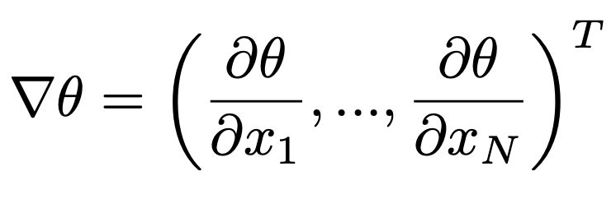
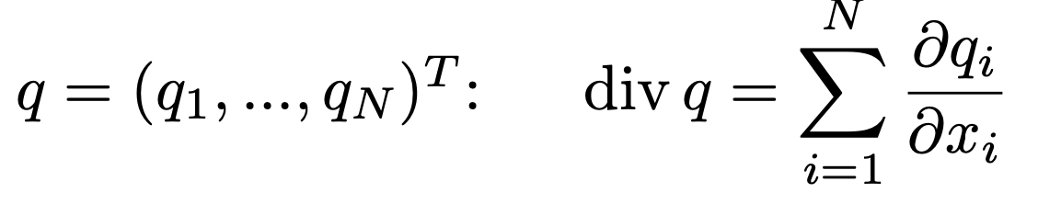
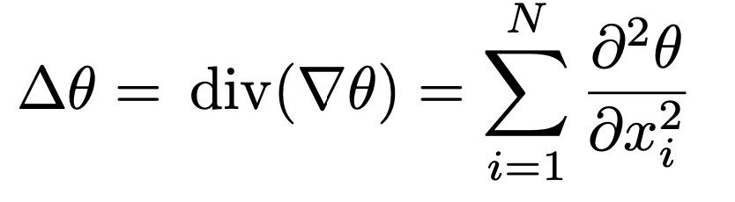
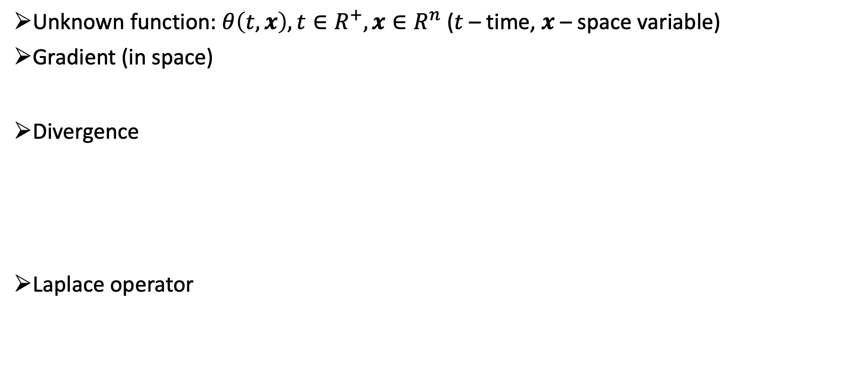
Example of modelling: convection-diffusion
Unknown function: $θ\left(t,x\right), t∈R^{+}, x∈R^{n}$ ($t$ – time, $x$ – space variable)
Gradient (in space)
Divergence
Laplace operator

Slide 12
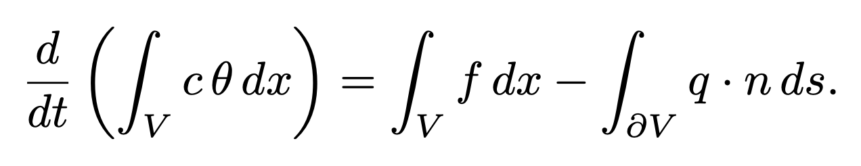
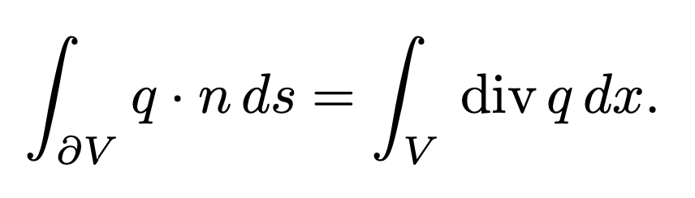
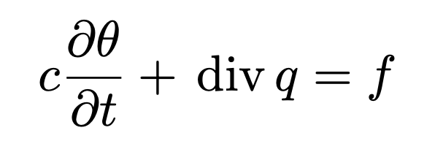
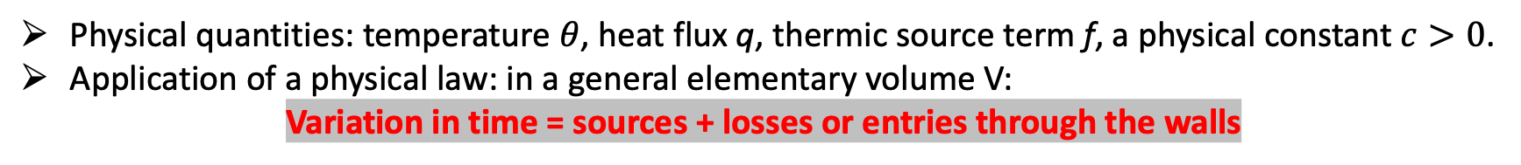
Application of physical laws
Physical quantities: temperature $θ$, heat flux q, thermic source term f, a physical constant $c>0$.
Application of a physical law: in a general elementary volume V:
Variation in time = sources + losses or entries through the walls
Application of Gauss’ theorem (or divergence theorem):
We permute the derivative in time and the integral over V. The volume V is arbitrary

Slide 13
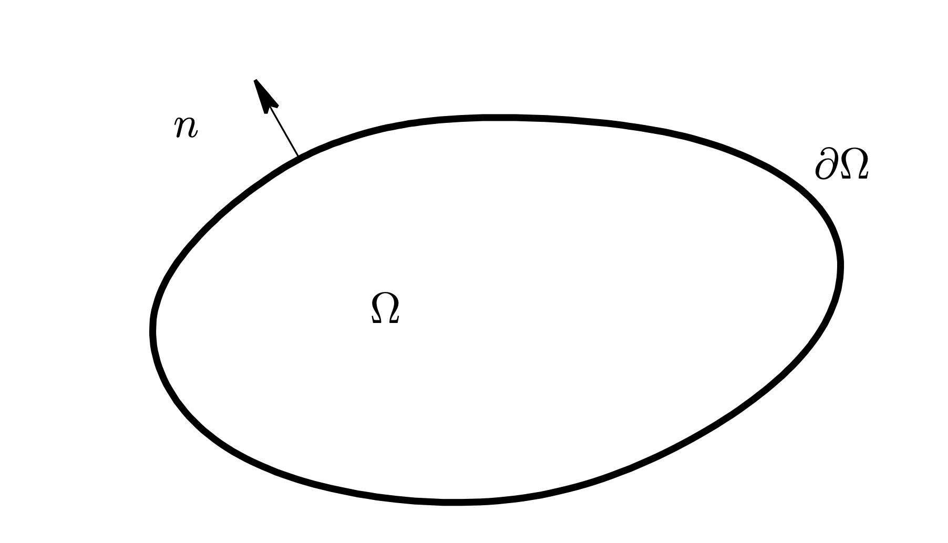
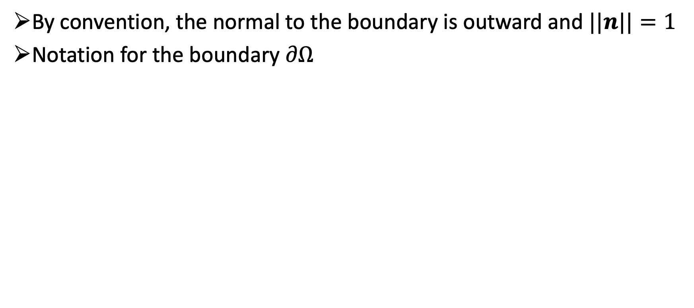
Computational domain and unit normal
By convention, the normal to the boundary is outward and $||n||=1$
Notation for the boundary $∂Ω$

Slide 14
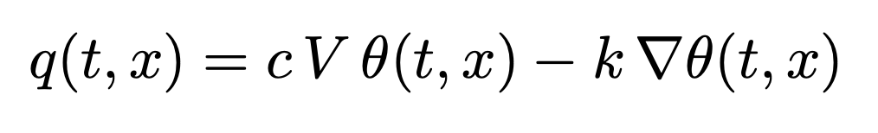
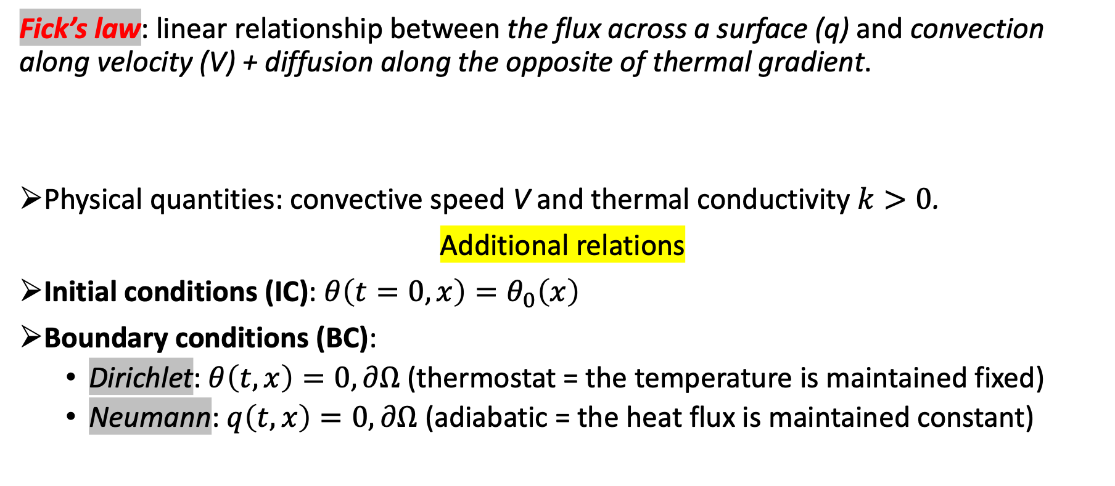
Constitutive laws (Fourier or Fick)
Fick’s law: linear relationship between the flux across a surface (q) and convection along velocity (V) + diffusion along the opposite of thermal gradient.
Physical quantities: convective speed V and thermal conductivity $k>0$.
Additional relations
Initial conditions (IC): $θ\left(t=0,x\right)=θ_{0}\left(x\right)$
Boundary conditions (BC):
Dirichlet: $θ\left(t,x\right)=0, ∂Ω$ (thermostat = the temperature is maintained fixed)
Neumann: $q\left(t,x\right)=0, ∂Ω$ (adiabatic = the heat flux is maintained constant)

Slide 15
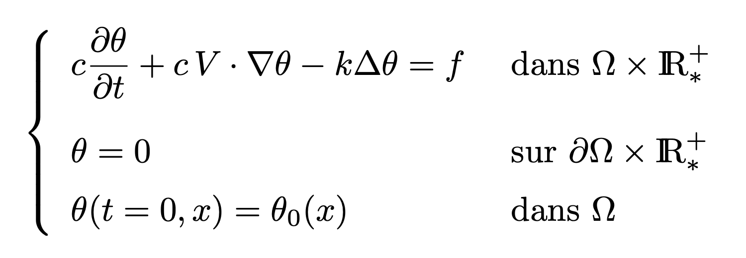
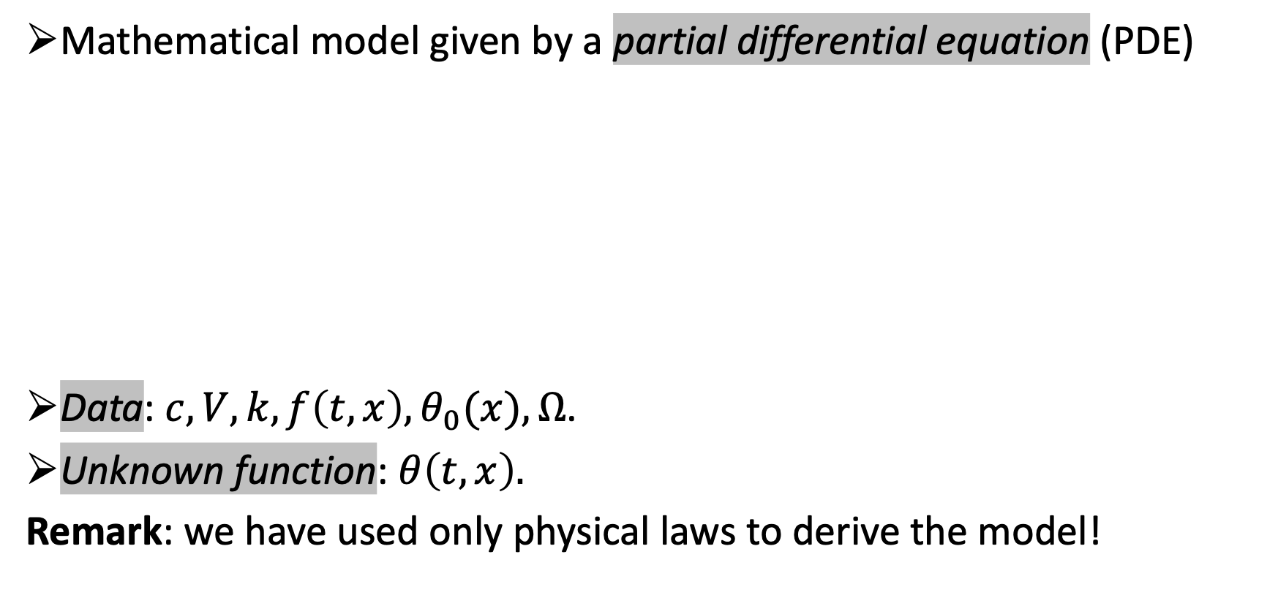
Convection diffusion-model
Mathematical model given by a partial differential equation (PDE)
Data: $c,V,k,f\left(t,x\right),θ_{0}(x),Ω$.
Unknown function: $θ\left(t,x\right).$
Remark: we have used only physical laws to derive the model!

Slide 16
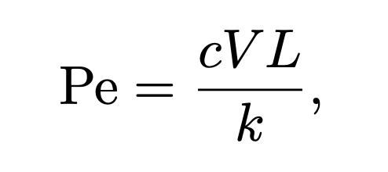
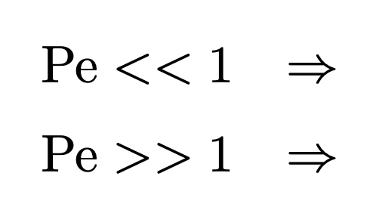
More mathematical modelling
Balance between the convection term and the diffusion term measured by a dimensionless quantity: the Péclet number
where L is a characteristic length (e.g. the diameter of the domain).
Further simplifications:
We end up with hree different models (heat, advection, advection-diffusion)!
Heat equation
Advection equation

Slide 17
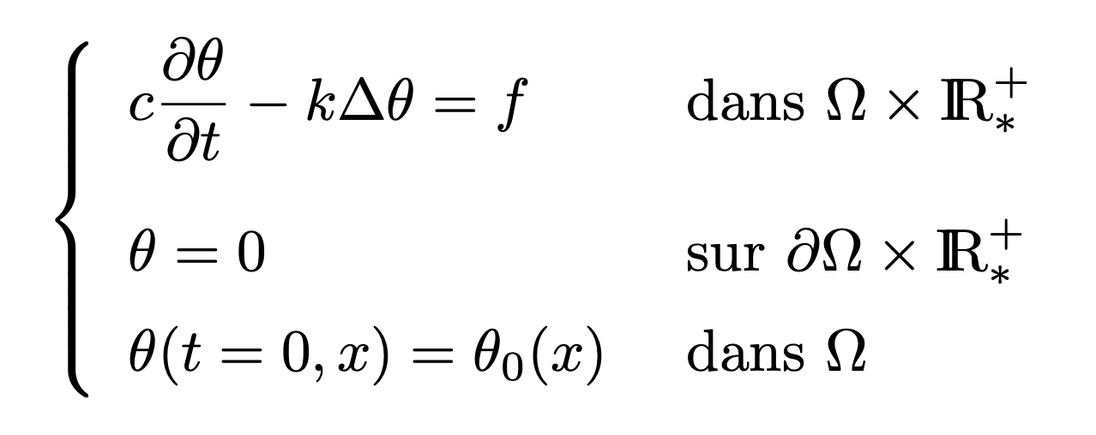
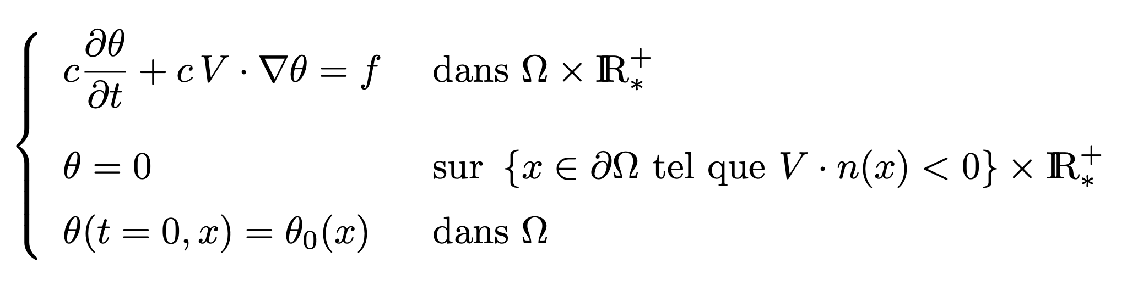
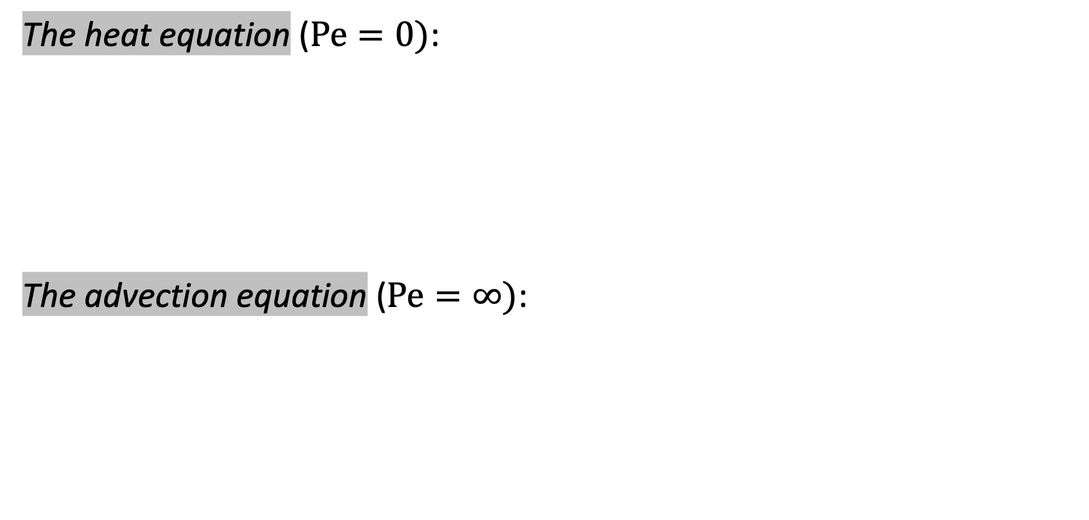
Simplified models
The heat equation ($Pe=0)$:
The advection equation ($Pe=∞)$:

Slide 18
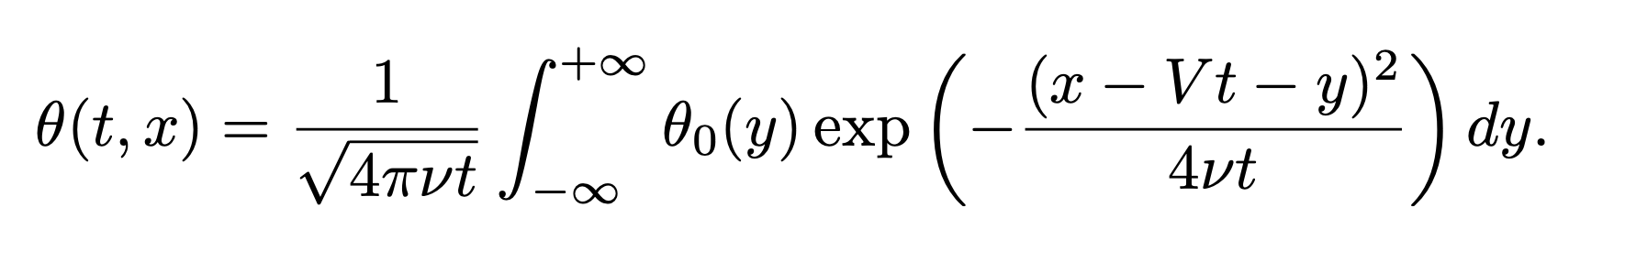
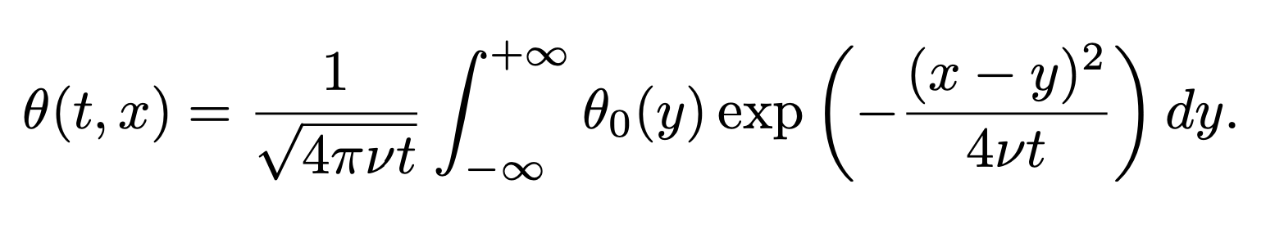
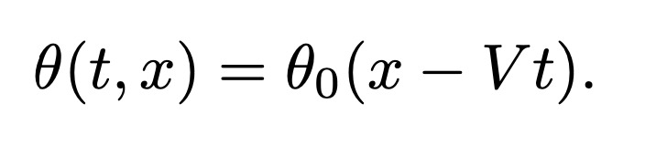
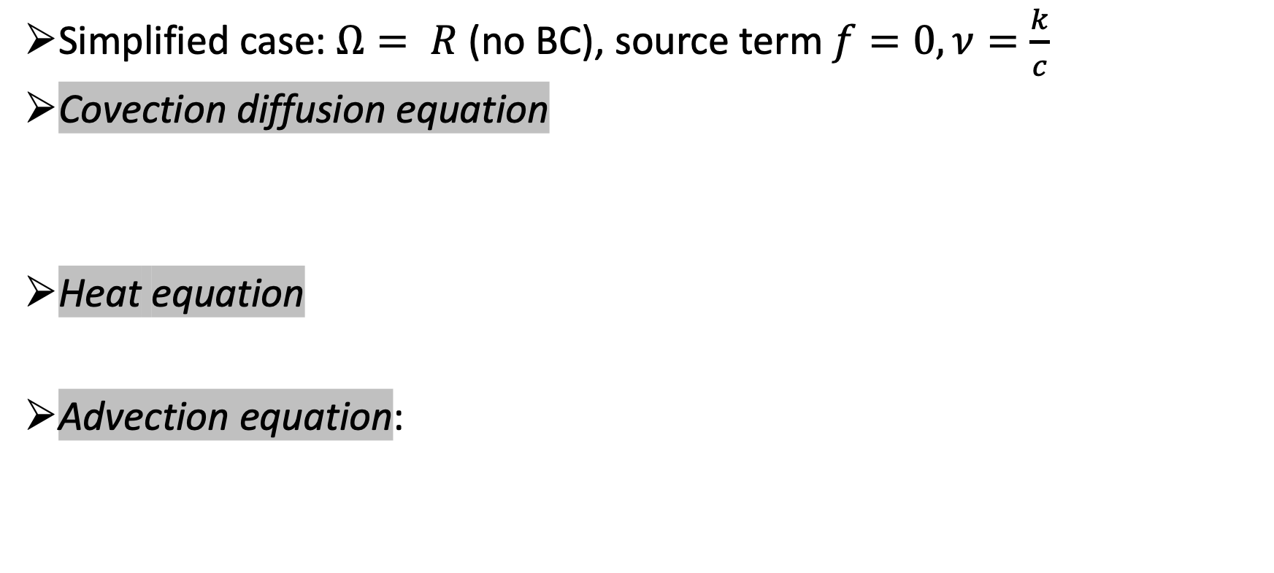
Explicit solutions – 1d case
Simplified case: $Ω= R$ (no BC), source term $f=0,ν=\frac{k}{c}$
Covection diffusion equation
Heat equation
Advection equation:

Slide 19
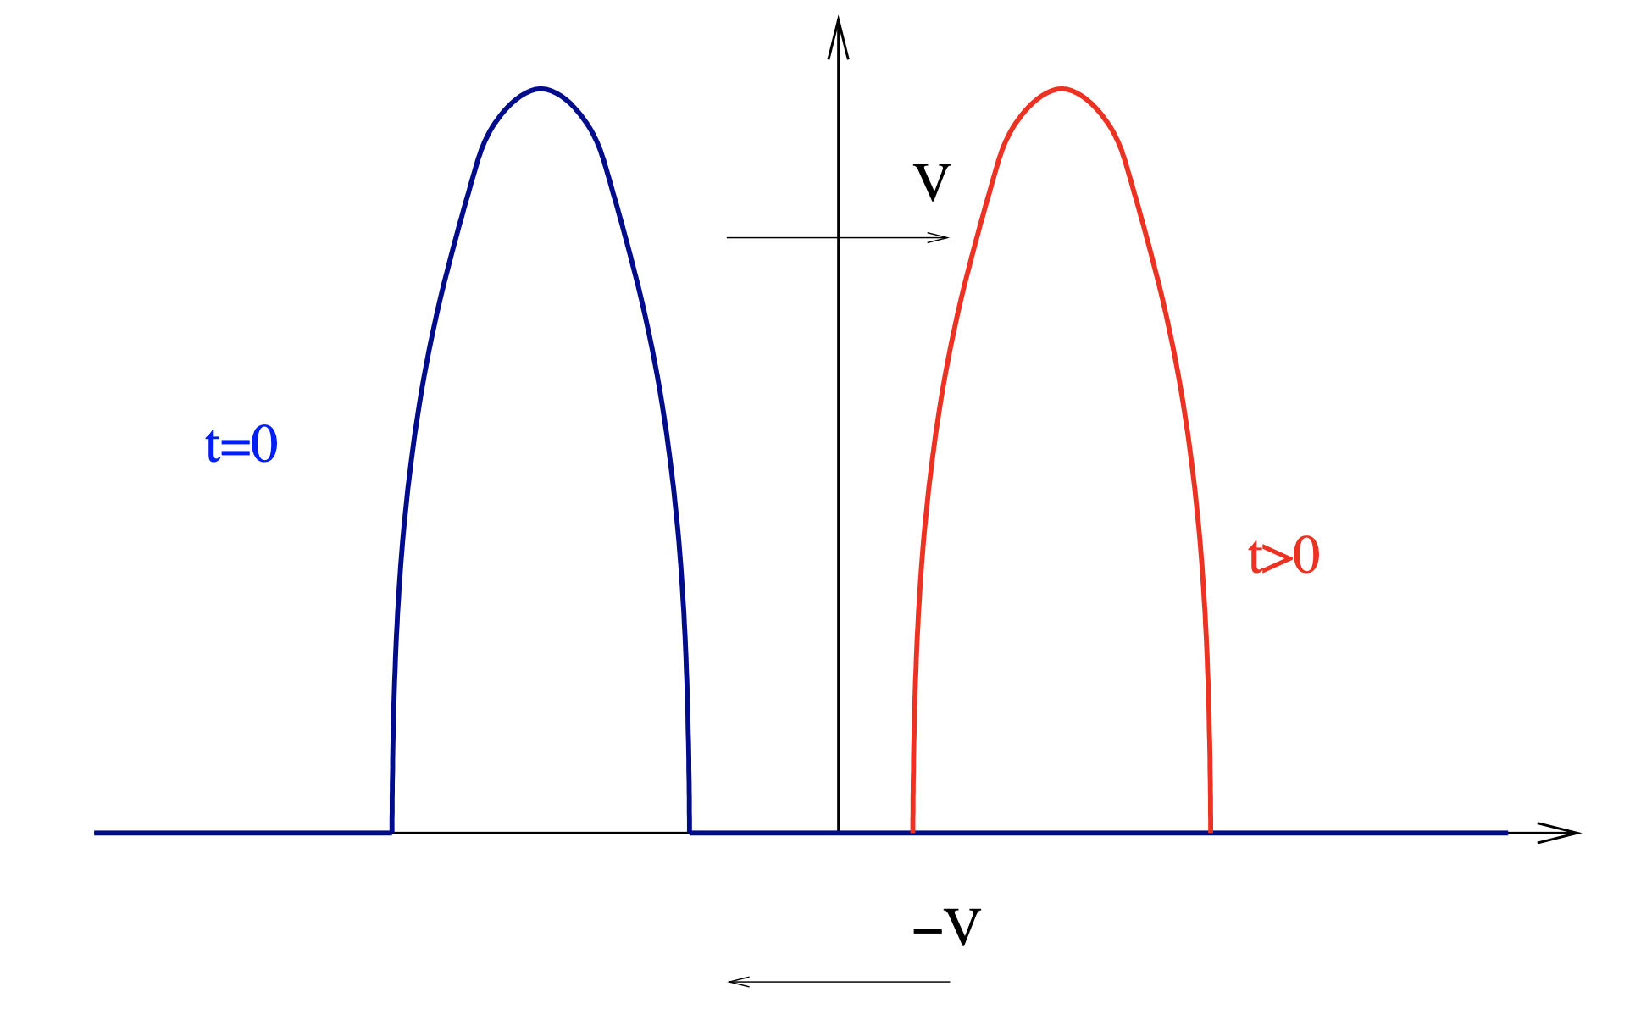
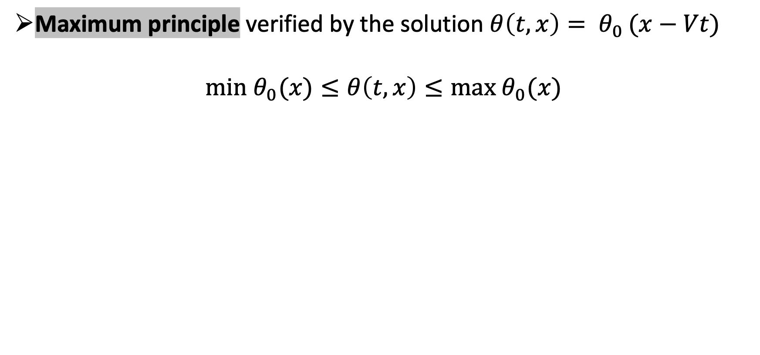
Properties – convection equation
Maximum principle verified by the solution $θ\left(t,x\right)= θ_{0 }(x−Vt)$
$$min θ_{0}(x)≤θ\left(t,x\right)≤max θ_{0}(x)$$

Slide 20
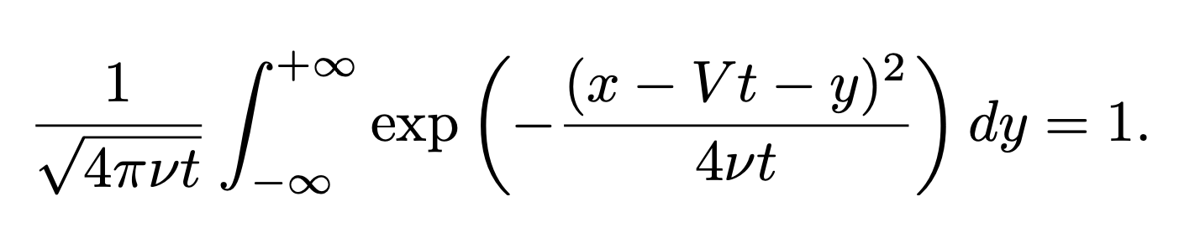
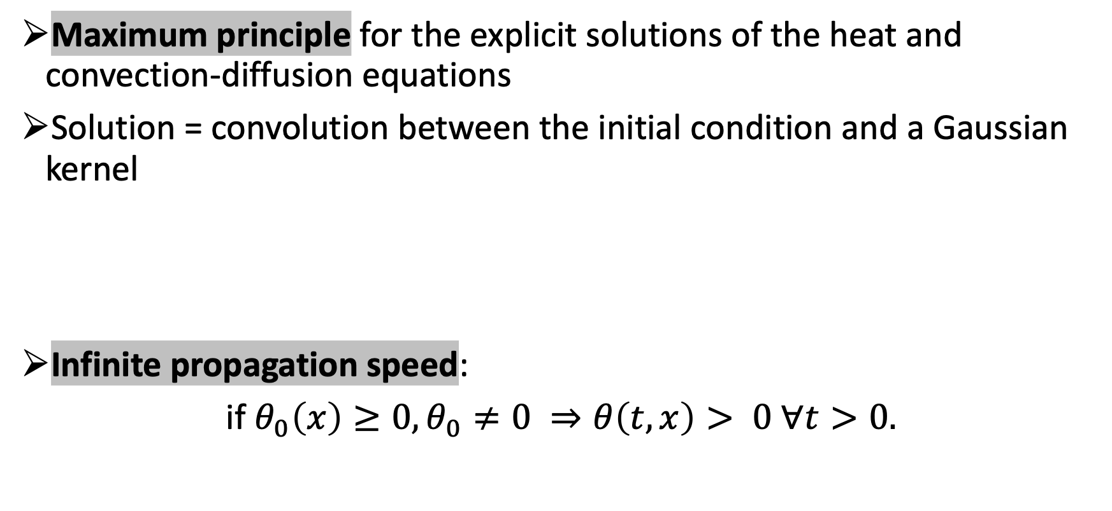
Properties – heat and convection-diffusion
Maximum principle for the explicit solutions of the heat and convection-diffusion equations
Solution = convolution between the initial condition and a Gaussian kernel
Infinite propagation speed:
if $θ_{0}\left(x\right)≥0, θ_{0}≠0 ⇒θ\left(t,x\right)> 0 ∀t>0.$

Slide 21
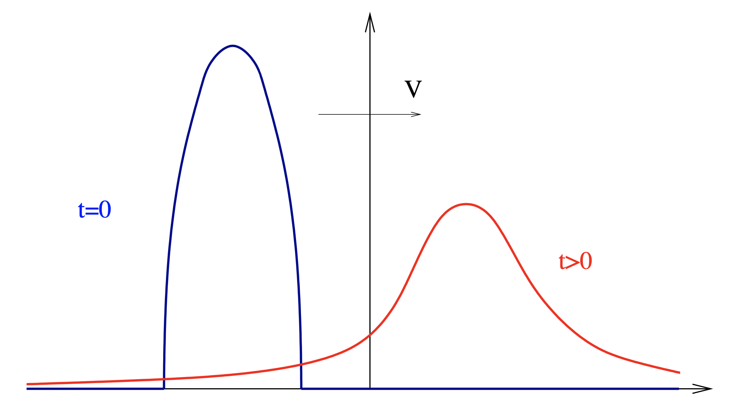
Solution of the convection-diffusion equation
Convolution of the initial condition with a Gaussian kernel.

Slide 22
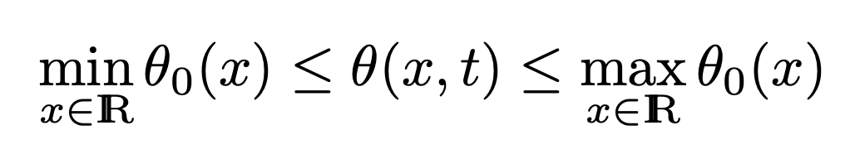
Analysis of the mathematical models
Maximum principle for the three models
(i)Reversibility: the advection equation is “reversible” in time but heat and convection-diffusion are irreversible.
Propagation speed: finite for the advection equation, infinite for the heat and convection-diffusion equation.

Slide 23
A few remarks
The same equation (convection-diffusion or heat equation) can model very different phenomena: option pricing in finance, concentration of a pollutant, fluid flows, electrostatics, etc…
There are a lot of models based on partial differential equations (PDE): linear elasticity, Navier-Stokes equations, Maxwell’s equations, etc..
PDEs can be classified according to their intrinsic and qualitative properties.

Slide 24
Well posed boundary value problem
Boundary value problem = PDE with boundary conditions on the entire domain boundary.
Cauchy problem = PDE where, for the time variable t, the “boundary” conditions are initial (and not final) conditions.
We say that the problem A(u) = f is well posed in the sense of Hadamard if for any given f it admits a unique solution u, and if this solution u continuously depends on the given f.
Necessary condition to do numerical computations!
Small variations in f (measurement or rounding errors) should only lead to small variations in u.

